Slide 1
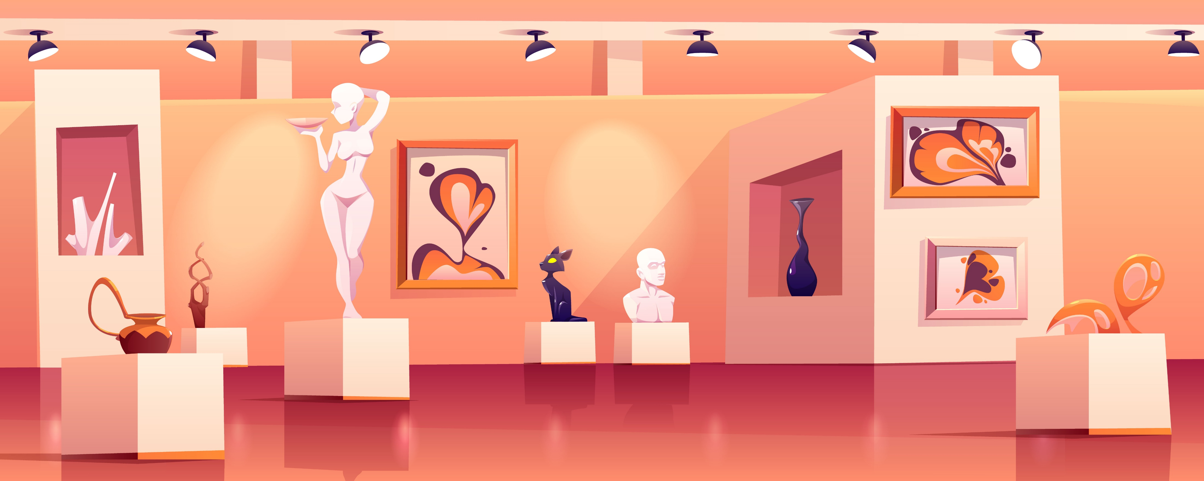
TALKING CHALKS
Domiziana Catalano Edoardo Puglisi Gianluca Panici

Slide 2
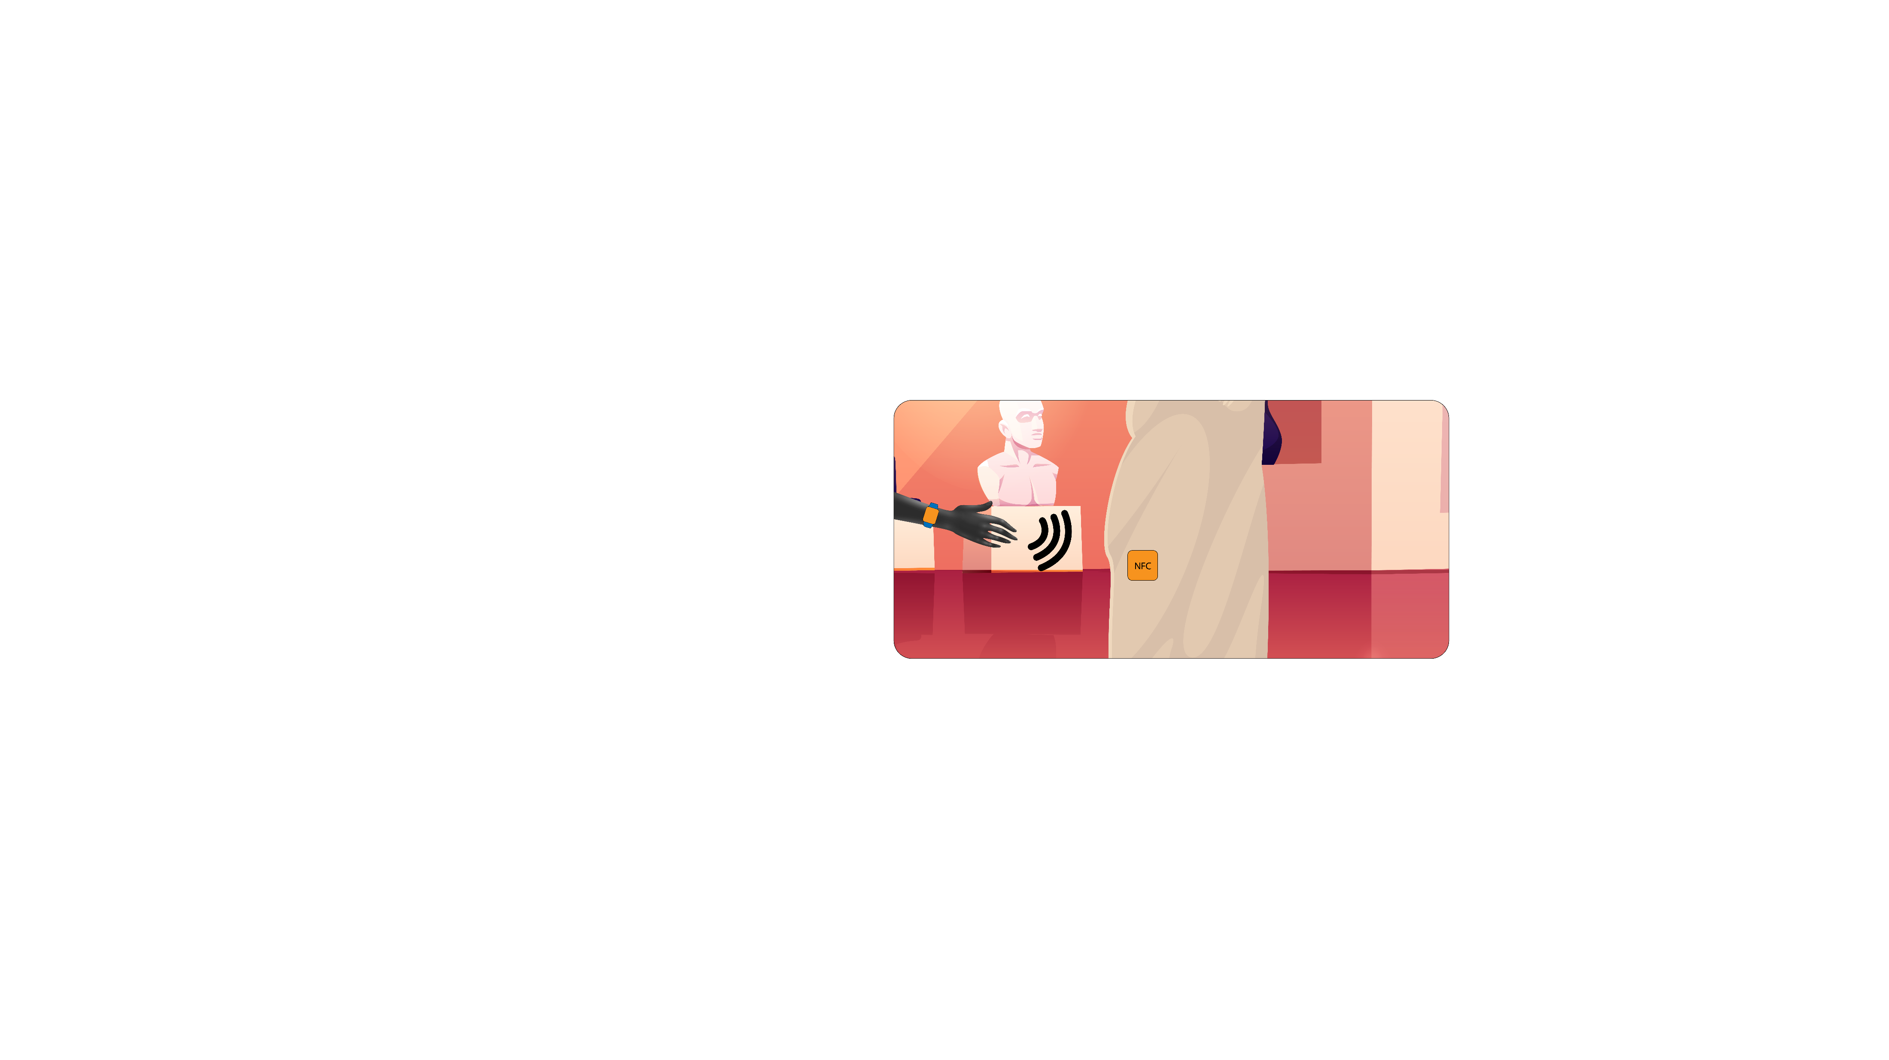
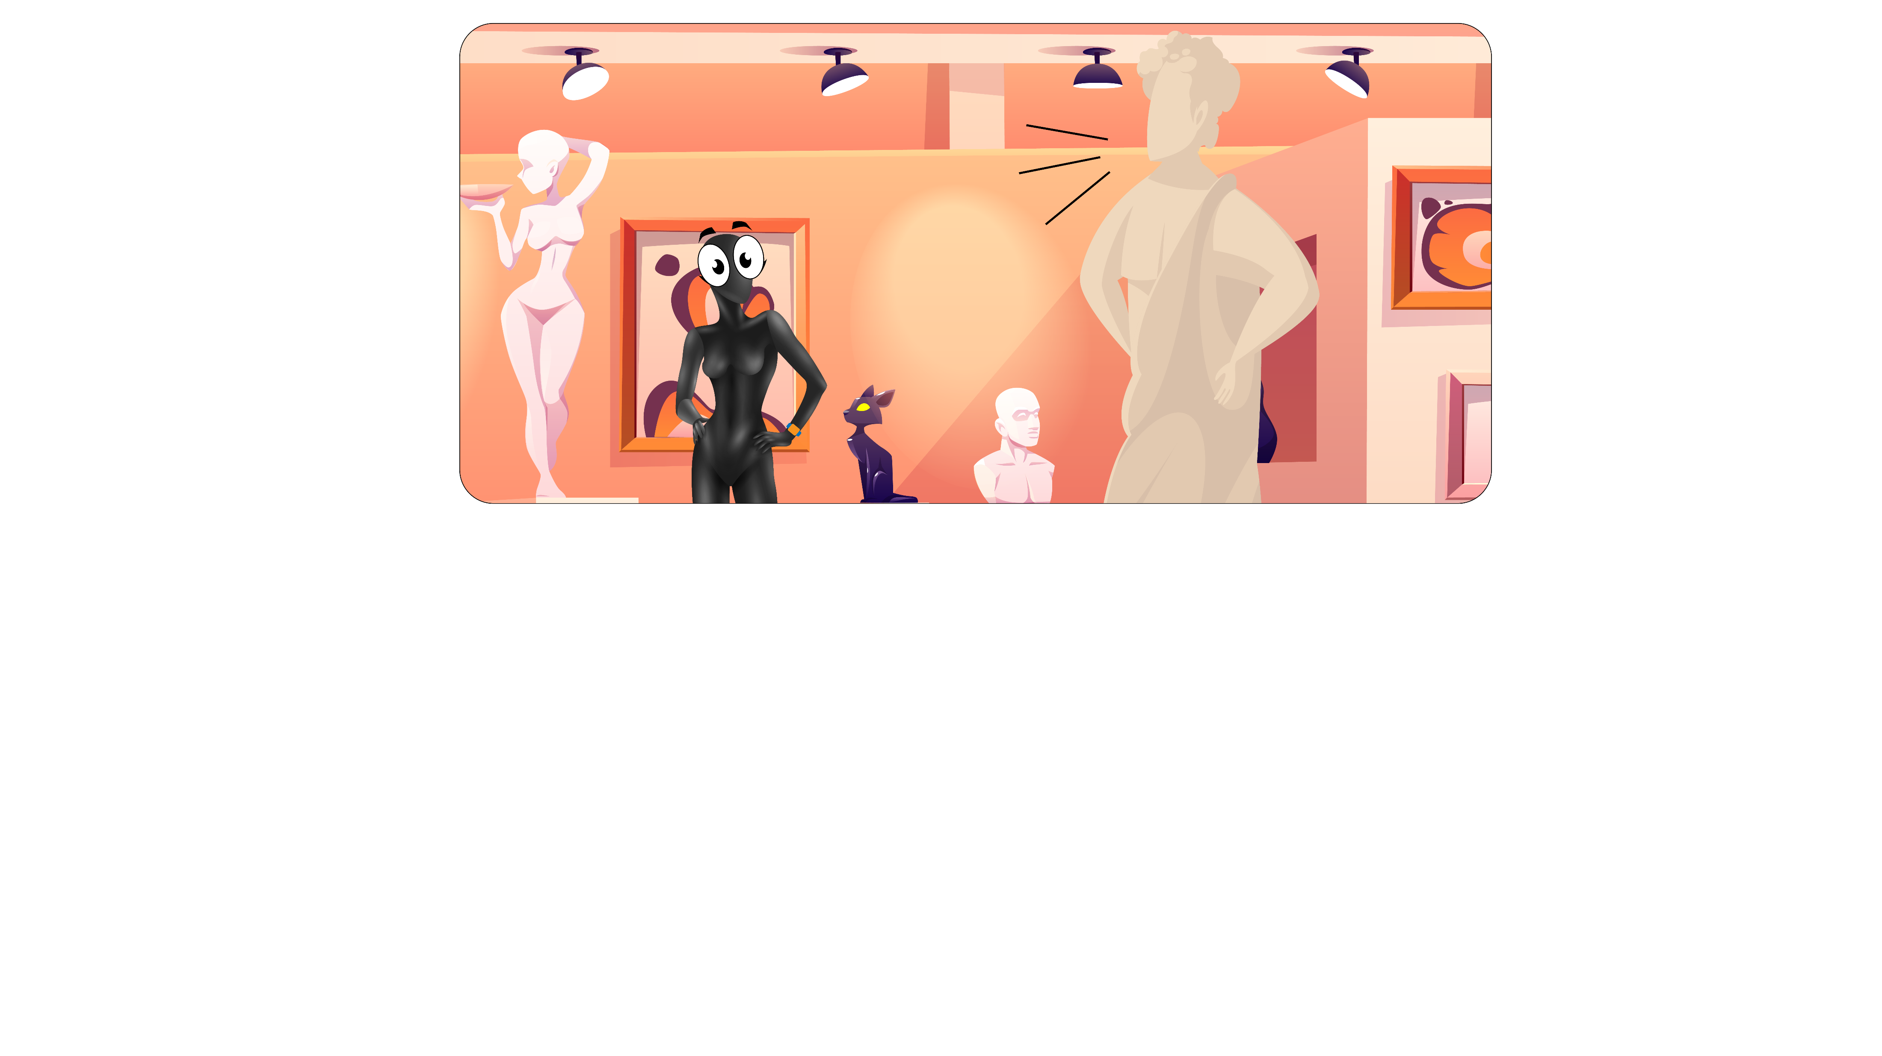
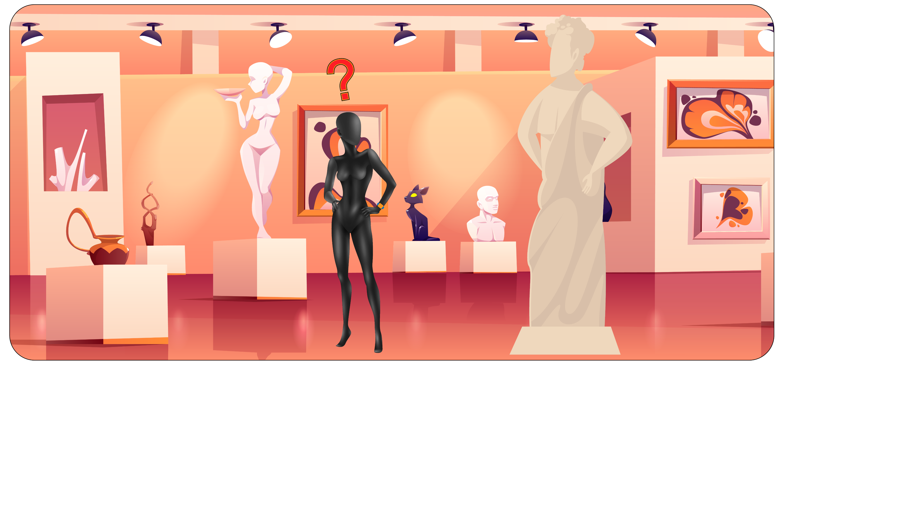
IDEA RECAP
Visitor happy and stoned hearing talking figures
New amazing technology comes to help him
Visitor confused and afraid of his ignorance

Slide 3
TALKING CHALKS
Domiziana Catalano Edoardo Puglisi Gianluca Panici

Slide 4
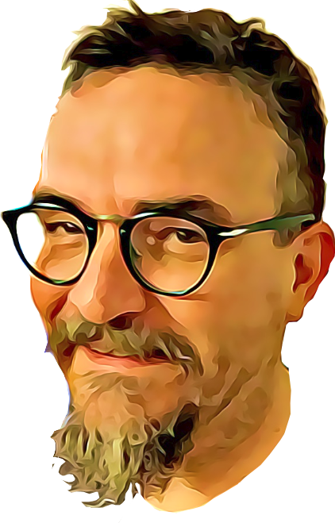

Survey results supported our idea:
KEY POINTS
CUSTOM TOUR – visitors can choose what kind of experience they want from the tour.
EASY/READY-TO-USE – just wear our band and enjoy the tour, that´s it! No smartphone or internet connection required, your grandpa won´t bother you anymore.
TRUSTED INFO – description are curated directly from the museum organization.
SCALABILITY – both for users and developers.
DATA – curators can understand which are the most visited statues of the museum and arrange tours according to this
Smart bands motivation is ok, but should be supported by questionnaires

Slide 5
TALKING CHALKS
Domiziana Catalano Edoardo Puglisi Gianluca Panici

Slide 6
SCALABILITY
FOR USERS
Thanks to smart-bands, new features can be implemented.
We can build up an user tracking infrastructure, implement health-safety system, new solutions for smart donations and founding.
Everything is possible with the technologies we have chosen.
SCALABILITY
FOR DEVELOPERS
Not only end user parts of the application are important, but also maintenance and code easiness: cause of our scalability purposes, the main word of our coding style is malleability.
Our code is designed to be quickly updated and modified. It is also ready to go out from TTN if needed.
With few commands it is ready to be tested and debugged.
We made it, you will use it, everyone will be able to repair it.

Slide 8
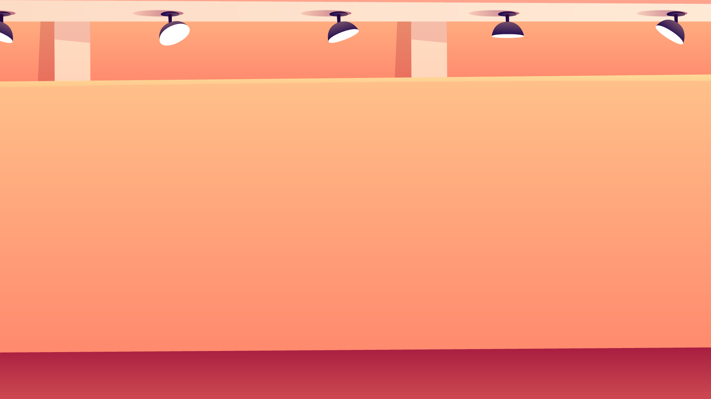
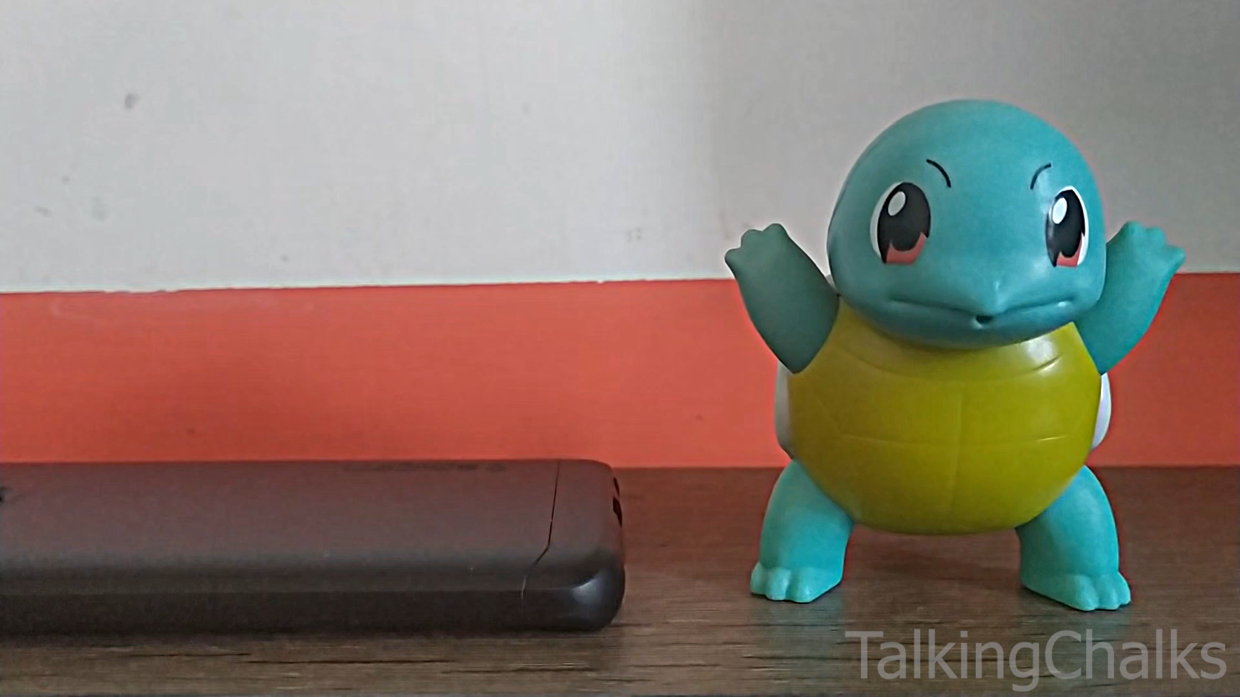
USER DEMO
Demonstration of TalkingChalks from the visitor’s point of view.
LoRa Board + Playback device simulated by a smartphone, while two different smartband´s profiles by two NFC tags. Squirtle as “Love and Psyche¨.

Slide 9
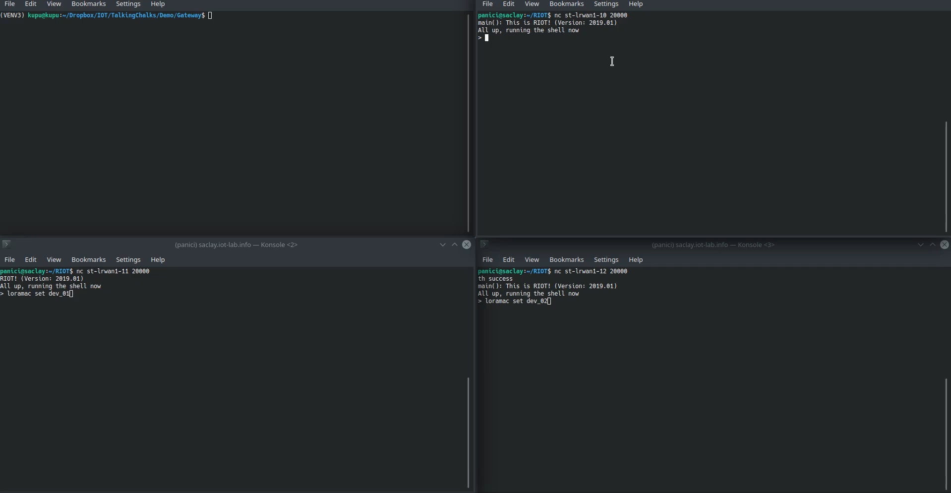
TECH DEMO
Meanwhile in the backyard…

Slide 10
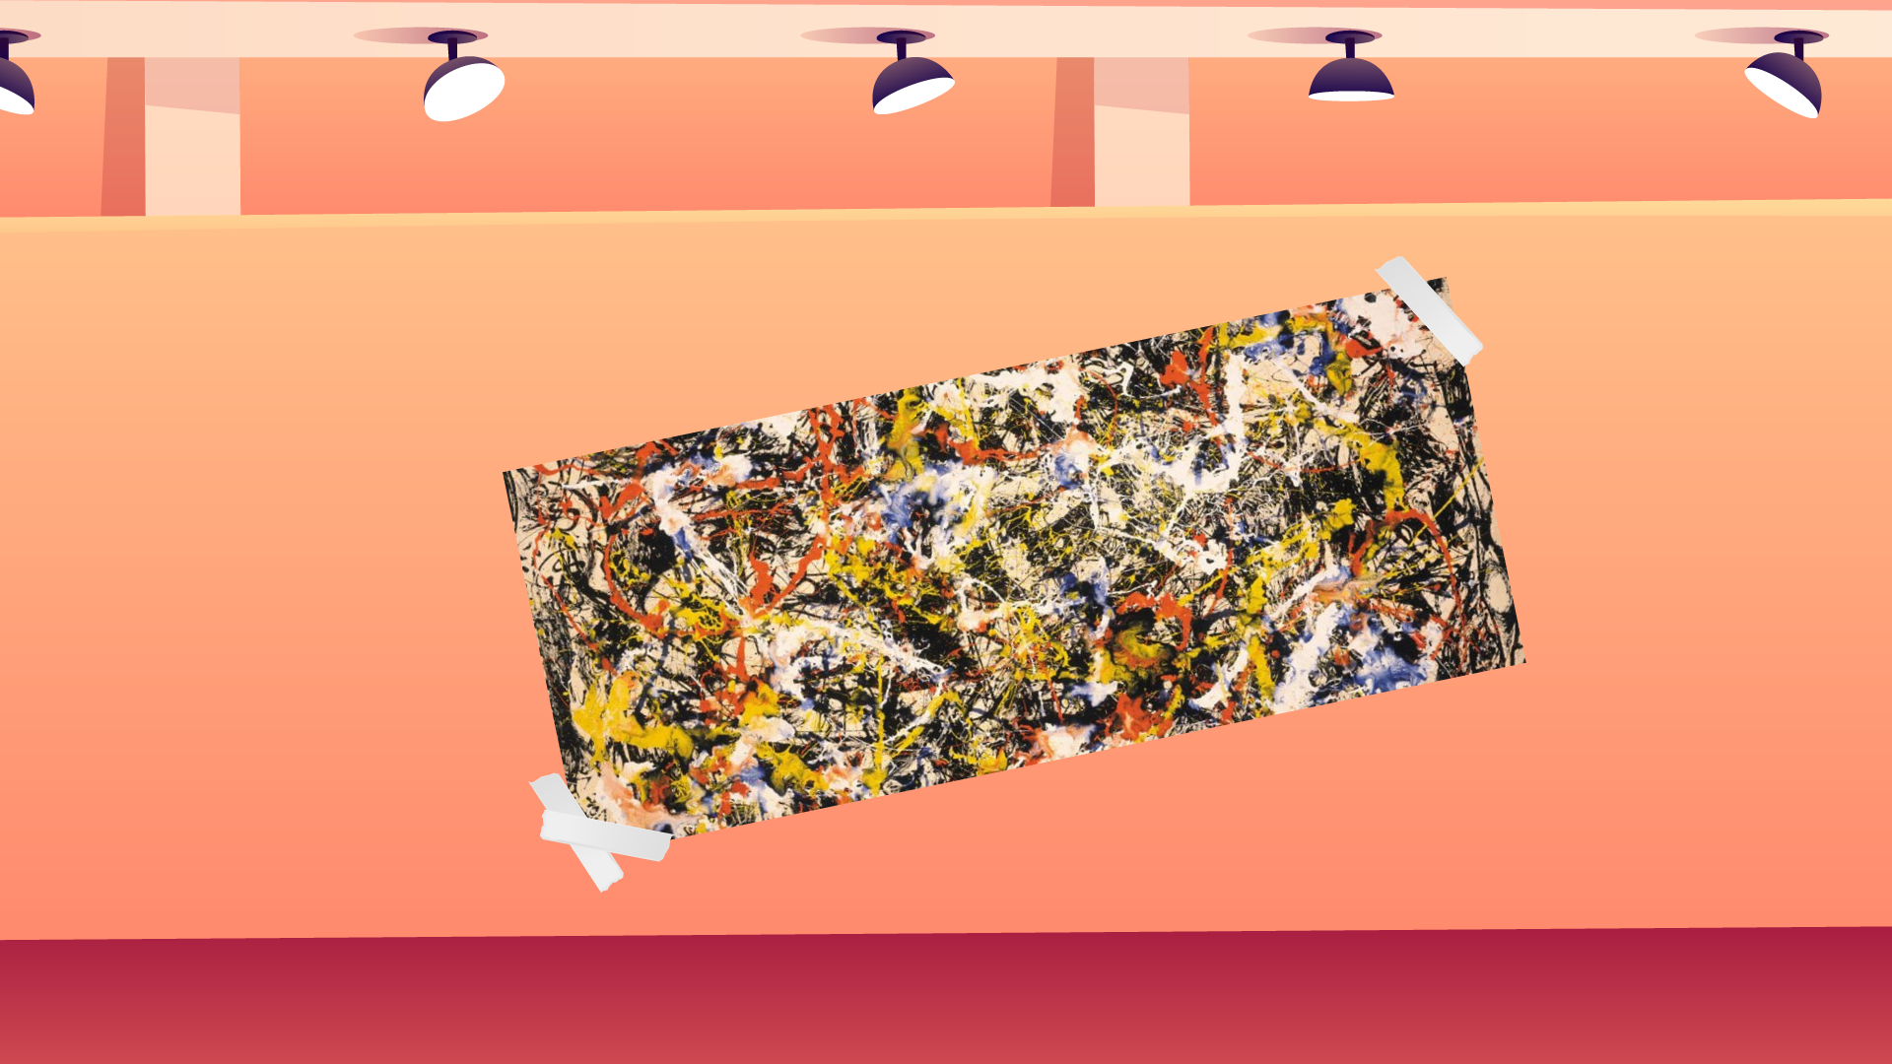
FUTURE EXHIBITION
Use visitor´s interactions with the statues
to generate an abstract painting and let them be part of the museum…
…and also detailed costs
evaluation.

